Slide 1
Relationships and Sex Education (RSE) at St Katherine’s
Jess Huzzey, Head of Philosophy and Beliefs, PSHE and Citizenship (huzzeyj@skdrive.org)

Slide 2
Relationships and Sex Education (RSE)
What has changed with the new statutory guidelines?
How are we doing things at St Katherine’s?
How can we address any concerns?

Slide 3
Relationships and Sex Education (RSE)
From September 2020, it has been compulsory to teach:
  Relationships and Sex education
  Physical health and mental well-being
Changes to parents’ Right to Withdraw have also been made

Slide 4
RSE: by the end of secondary school, pupils should have been taught about (topics):
Families
Respectful relationships, including friendships
Online and media
Being safe
Intimate and sexual relationships, including sexual health
The law and how it relates to these issues
Notes:
marriage • consent, including the age of consent • violence against women and girls • online behaviours including image and information sharing (including ‘sexting’, youth-produced sexual imagery, nudes, etc.) • pornography • abortion • sexuality • gender identity • substance misuse • violence and exploitation by gangs • extremism/radicalisation • criminal exploitation (for example, through gang involvement or ‘county lines’ drugs operations) • hate crime • female genital mutilation (FGM)

Slide 5
Health: by the end of secondary school, pupils should have been taught about:
Mental wellbeing
Internet safety and harms
Physical health and fitness
Healthy eating
Drugs, alcohol and tobacco
Health and prevention
Basic first aid
Changing adolescent body

Slide 6
Parents’ right to withdraw has changed
Parents have the right to withdraw their child from all or part of the sex education delivered as part of statutory RSE
Not from sex education as part of the science curriculum
Not from any other part of PSHE, such as Health or Relationships Education
Up to and until three terms before the child turns 16. After that point, if the child wishes to receive sex education rather than be withdrawn, the school should make arrangements to provide the child with sex education during one of those terms.
Parents should address any queries or concerns about the curriculum to the Head of PSHE (huzzeyj@skdrive.org) in the first instance
Requests to withdraw students will be granted after discussion in all but exceptional circumstances

Slide 7

How RSE is delivered at St Katherine’s
As part of PSHE – fortnightly timetabled lesson in KS3 and in ‘Society and Culture’ lessons in KS4.
Through the tutor programme in sixth form.
Delivered by a small team of humanities teaching staff.
Occasionally, with input from specific external agencies E.g. Brook

Slide 8
Example unit of work (Relationships)
Year 8 Unit: Identity and Relationships
1. Gender diversity
2. LGBTQ+ and pride
3. Love and respect
4. Long-term relationships
5. Abusive relationships
6. Online sexual harassment
7. The dangers of sexting

Slide 9
Example unit of work (Sex)
Year 9 Unit: Intimate Relationships
1. Readiness for sex
2. Consent
Risks of unprotected sex
4. Objectification and gender double standards
5. Sexual bullying
6. Sex in the media

Slide 10

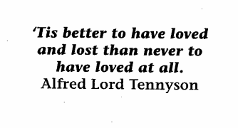
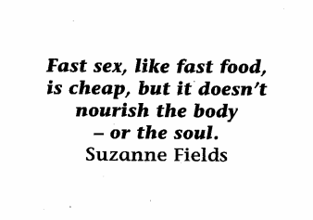
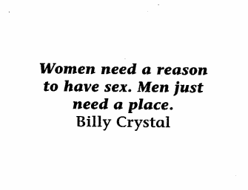
Readiness for Sex
Example lesson activity (yr 9)
Do now: In small groups, pick your three favourite quotes about love or sex.
Which do you like and why?
Notes:
How important is sex alongside work, religion, family, children, sport etc?

Slide 11
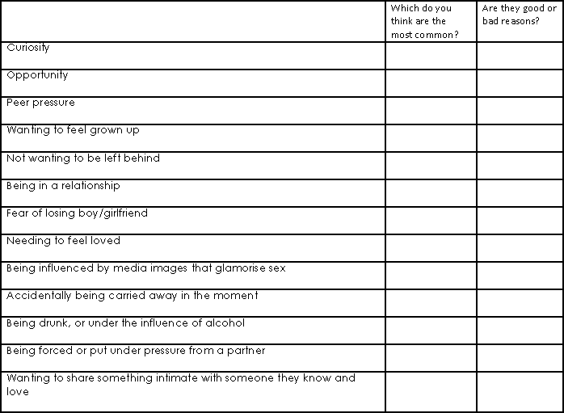
Why do people choose to have sex for the first time?
Example lesson activity (yr 9)
Read through reasons people give about why they have their first sexual experience and complete the two columns.
Perhaps rank the top five most common reasons and put a tick or cross in the good/bad column.
Notes:
Is the peer pressure real or imagined?
Why might people have sex if they need to feel love? (Belief that sex=love. Discuss)
Are the best reasons also the most common?
Which reasons might be risky? Why?
How can first time sex be made safe and enjoyable?

Slide 12
Misconceptions and Concerns
RSE will expose my child to content that they are not yet mature enough for.
The curriculum and lessons are designed to be age appropriate.
Teachers have drawn from their own experience and from advice from agencies such as the PSHE Association.

Slide 13
Misconceptions and Concerns
Encouraging conversations about sex will result in my child being exposed to misinformation from peers or feeling alienated.
A well-structured lesson delivered by trained professionals provides an excellent opportunity for misinformation to be challenged.
Strict ground rules ensure students do not share personal information and speak respectfully.
Notes:
Ground rules

Slide 14
Misconceptions and Concerns
RSE at school may promote a lifestyle or an agenda that I don’t agree with.
RSE aims to keep children safe and prepare them for life beyond school, promoting respect for diversity, in alignment with the school’s values and in compliance with the Equalities Act (2010).

Slide 15
Consultation with parents
We understand that parents are the “first teachers” for their children – you have the most significant influence in enabling your children to grow, mature and form healthy relationships
In order to support you with this, we need to keep you informed about what we will be teaching in school and when.

Slide 16
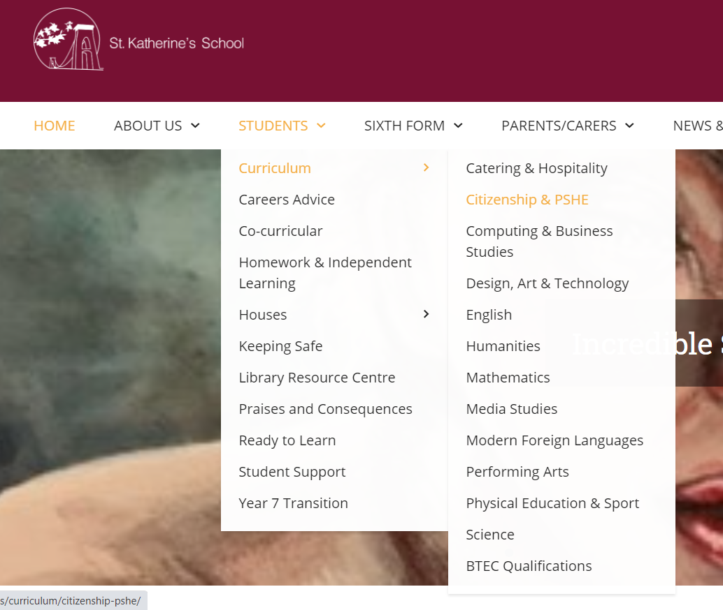

Slide 17
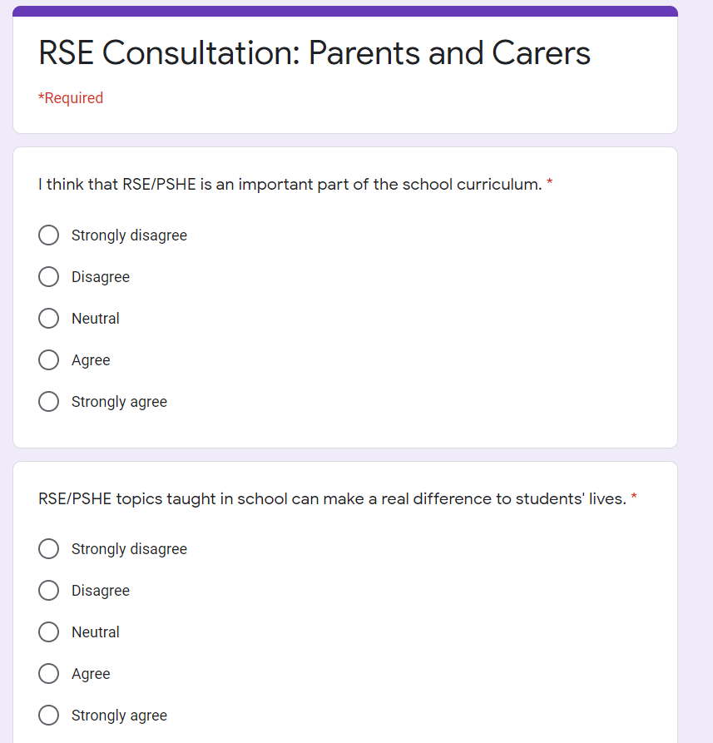
Parent and Carers Feedback questionnaire
We collect feedback from students about their learning experience in PSHE through anonymous surveys
We will also be requesting feedback from parents and carers about RSE in the near future
Email me with any concerns or queries: huzzeyj@skdrive.org

